Slide 1
BGI Pilot scRNA-Seq Discussion
07.07.2021

Slide 2
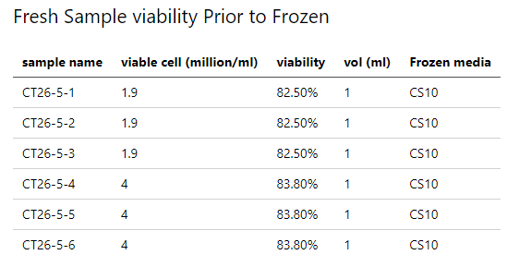
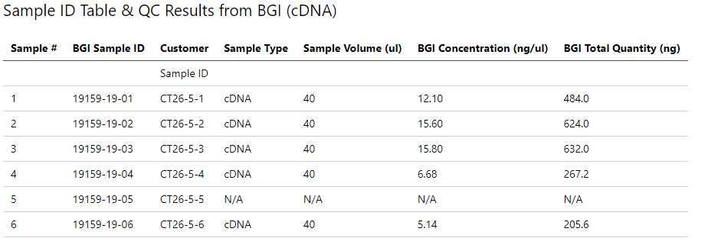
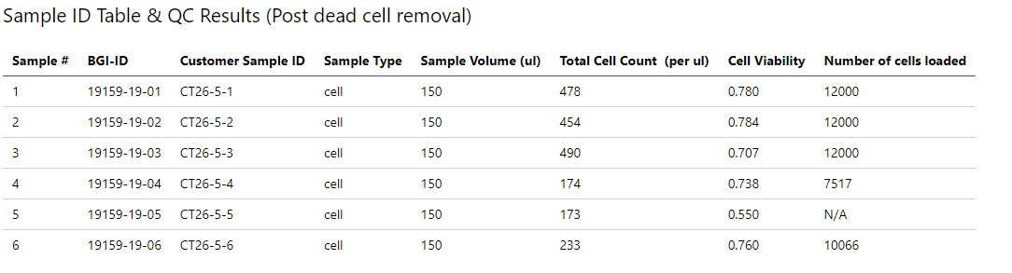
Sample Quality Control
Fresh Sample
had consistent viability
Sample 1-3: 1.9 million
Sample 4-6: 4 million
Library Preparation & QC
Quality and Cell Loading different between 1-3 vs 4-6
Cell Viability, inconsistent despite the consistent viability

Slide 3
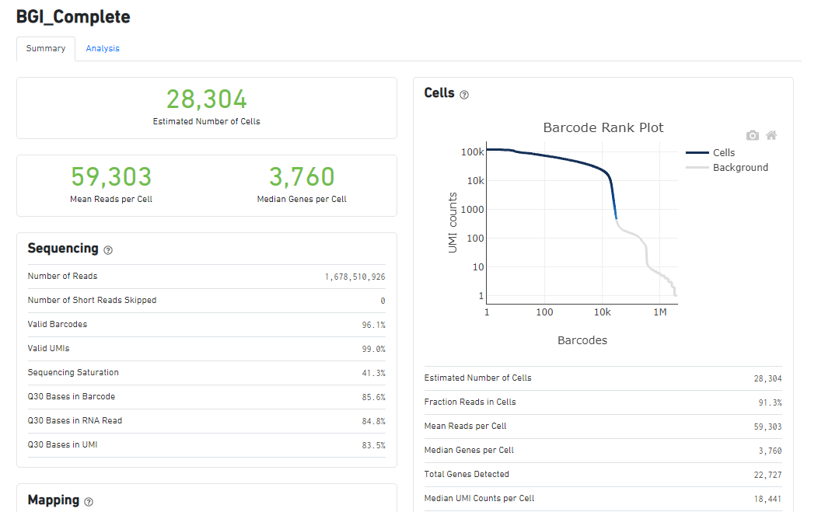
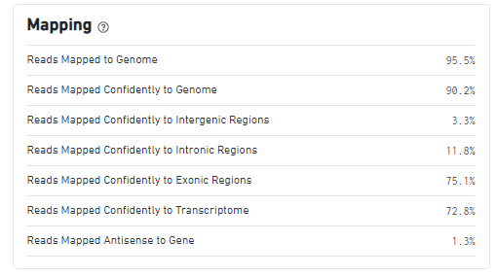
Cell Ranger Basic Metrics

Slide 4
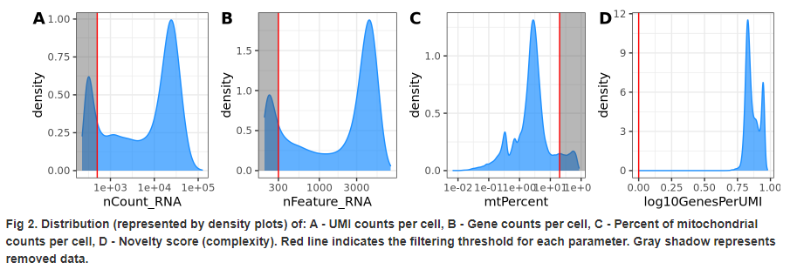
Distribution of UMI, Gene Counts, Mitochondrial

Slide 5
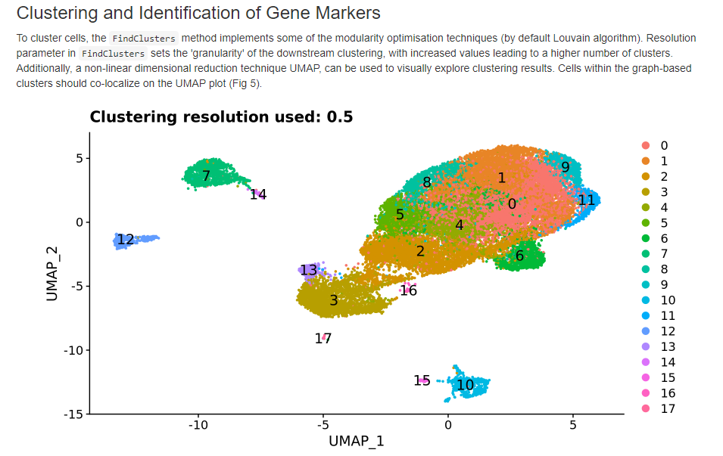
UMAP of Data

Slide 6
Backup

Slide 7
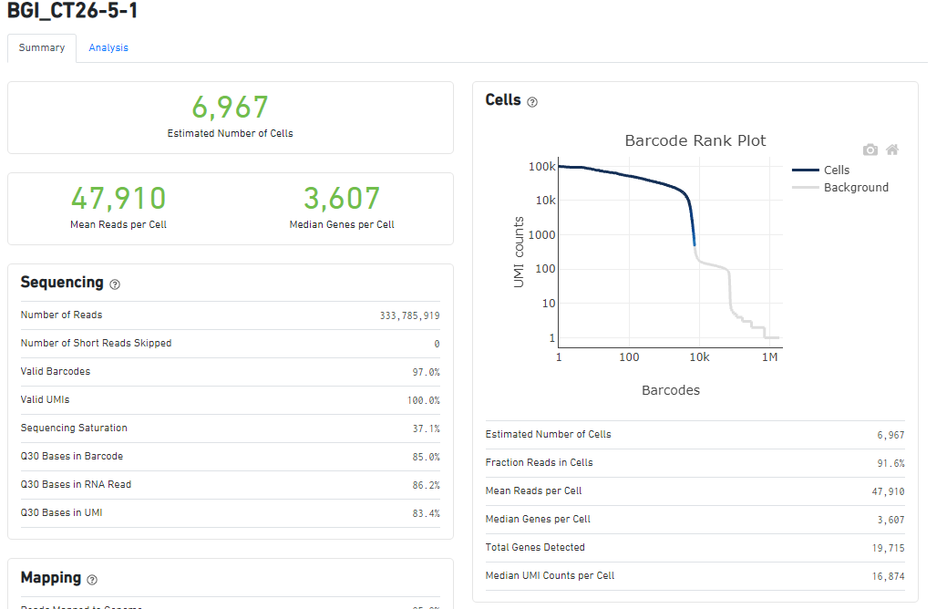
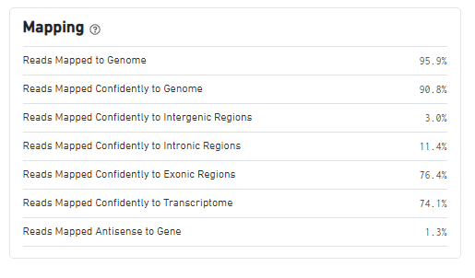

Slide 8
